Slide 1

Bug Zapper
ESE440: Thomas Suarez, Ricky Zhang, Frank Yee
Project Proposal:Prof. David Westerfeld
Fall 2016

Slide 2
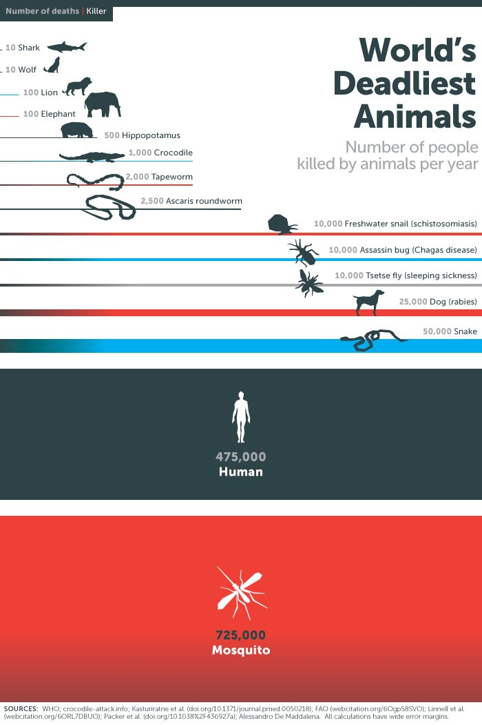
Project Background
Mosquito borne diseases:
Malaria
Zika
Yellow fever
Based on infograph Mosquitos account towards 55% of total deaths.
Notes:
Comes out to like 55.29%

Slide 3

Solution(s) to Mosquito Control
One method currently used in insect population control is the use of bug zappers. Bug zappers are usually a trap which is composed of bait, and a method to kill the insect. The bait will typically be UV light and once the target is within the trap, a high voltage electric shock will eliminate anything that makes contact.
Current Methods

Slide 4
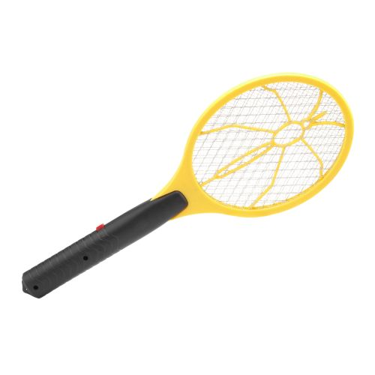
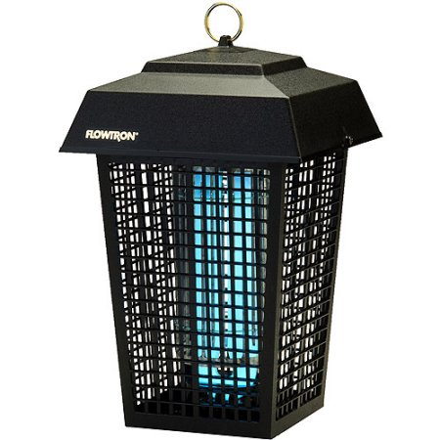
Bug Zappers Today
Notes:
Left is a 10$, Right is 50$
No bait on left, UV light bait on Right

Slide 5
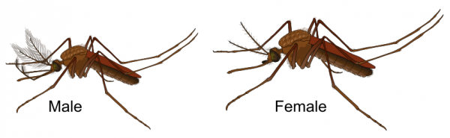
Our Proposed Solution to Mosquito Control
Although current methods may be effective in eliminating insects, the problem lies in the inability to differentiate between insects and mosquitos. To detect a mosquitoes, two important changes will be made to the current bug zappers. A microphone and DSP (digital signal processing) will be used in order to detect and eliminate the target.
Design task: To improve current methods
Notes:
Study done by study by the University of Delaware found that only 31 of 13 789 insects killed in traps were biting insects only .2%
To get even more precise we want to target female mosquitos not males, they are the ones that bite and spread illness.
Without getting too into biology, the anatomy of a male and a female mosquito are actually slightly different. Females tend to be bigger, means bigger wings. This is significant because such difference results in a different pitched buzzing, which is critical for our frequency detection.

Slide 6



Design task:
Notes:
Microphone
Pi used for Processing and maybe future communications with android for app usage
Transformer -> zappy part

Slide 7

Design Constraints
-The circuit must filter out noise as much as possible to prevent false readings.
-The sampling frequency of the microcontroller must be at least double the input frequency that is being read.
-The zapper must have enough voltage to zap a mosquito around 4000V.
Notes:
Possible delays? More complexity, more factors to take account eg. Layers of filtering, tradeoff between precision and processing speed

Slide 8

Ethical Issues
-Accidently killing insects that share the same frequency range.
-Killing too many female mosquitos. Can affect the overall mosquito population and disrupt food-chains.
-However at the same time, we can reduce the number of deaths and infections caused by mosquito diseases.
Pros and Cons

Slide 9

Multidisciplinary Team Discussion
-Research
-Analog System Design
-Digital Circuit Design
-Programming of Microcontroller
Team of Three
Notes:
Talking to other professors and students for thoughts and comments.

